Slide 1
Design and Analysis of Algorithms CS345
Lecture 19
Network Flow

Slide 2
Algorithm Design Paradigms
Divide and Conquer
Greedy Strategy
Dynamic Programming

Slide 3
Designing an algorithm
Fresh approach
Working on examples
Learning from mistakes
Theoretical formulation

Slide 4
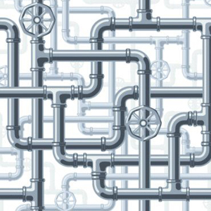
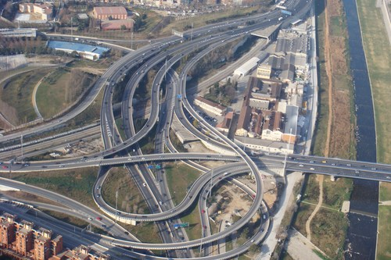
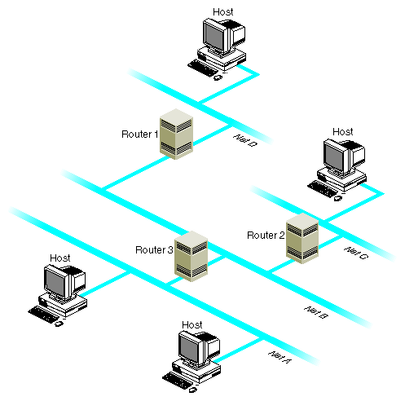
Network

Slide 5
Maximum Flow in a Network

Slide 6



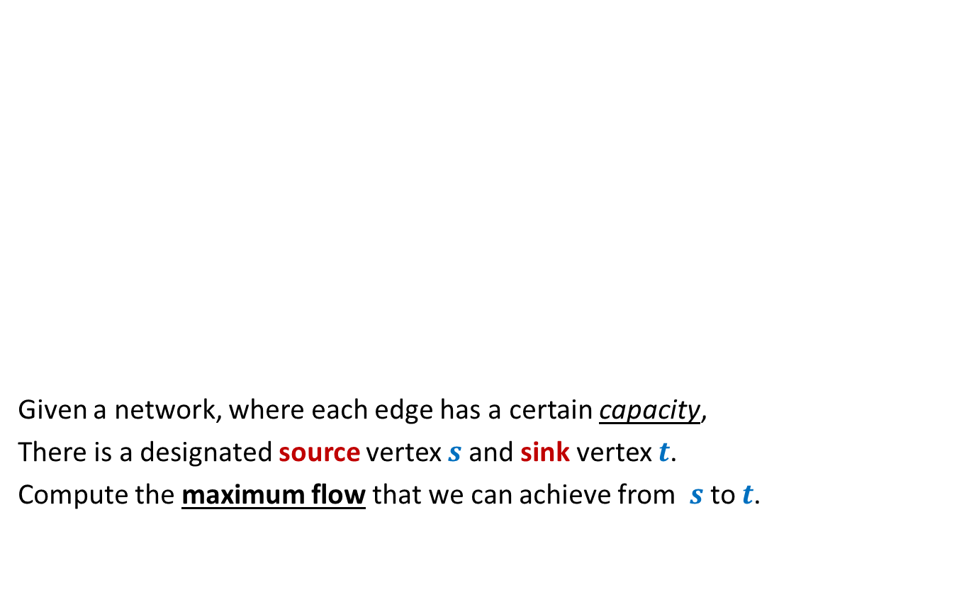



Problem definition (Informal)
2
Given a network, where each edge has a certain capacity,
There is a designated source vertex $s$and sink vertex $t$.
Compute the maximum flow that we can achieve from $s$to $t$.
$$v$$
$$x$$
5
6
15
8
$$t$$
$$s$$
6
7
14
7
17
$$u$$
4
$$y$$

Slide 7
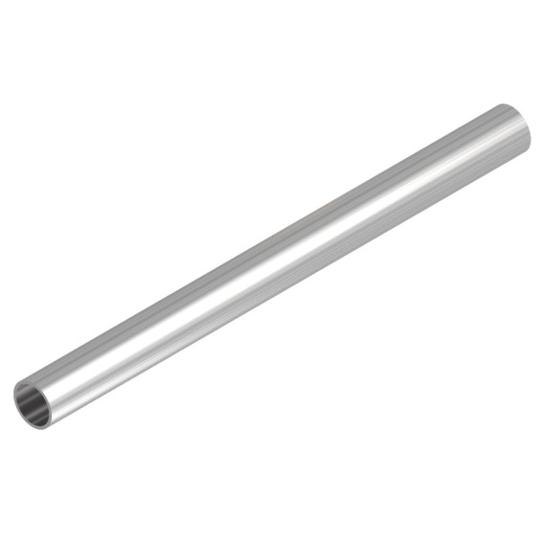
Question: What is flow along an edge ?
Answer: The rate at which the commodity is being transported along the edge.
Question: What is capacity of an edge ?
Answer: The maximum rate at which the commodity can be transported
along the edge.
Example: 25 litre/sec
1 GB /sec
An edge

Slide 8





Are there any constraints for a flow ?
$$x$$
$≤$25
Capacity constraint :
Flow along an edge cannot exceed its capacity
Conservation constraint :
Flow entering node $u$ = Flow leaving node $u$.
25
$$u$$
5
$$u$$
25
20

Slide 9
Formal Description of Flow

Slide 10
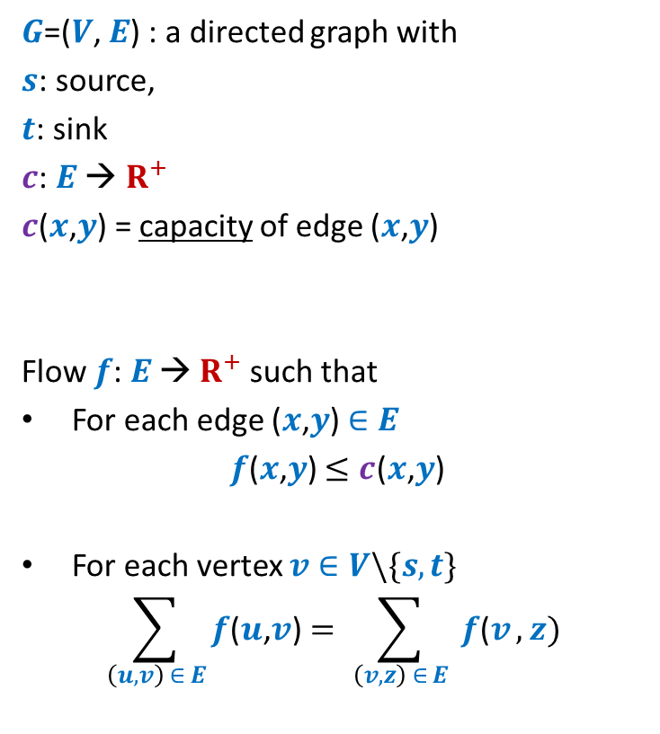
Formal Description of Flow
2
$G$=($V$, $E$) : a directed graph with
$s$: source,
$t$: sink
$c$: $E$ → $R^{+}$
$c$($x$,$y$) = capacity of edge ($x$,$y$)
Flow $f$: $E$ → $R^{+}$ such that
For each edge ($x$,$y$) $∈E$
$f$($x$,$y$) $≤c$($x$,$y$)
For each vertex $v∈V\backslash \{s,t\}$
$$\sum_{\left(u,v\right) ∈ E}{f\text{(}u\text{,}v\text{)}}=\sum_{ \left(v,z\right) ∈ E }{f\text{(}v},z)$$
$$v$$
$$x$$
5
6
15
8
$$t$$
$$s$$
6
7
14
7
17
$$u$$
4
$$y$$
Capacity constraint
Conservation constraint

Slide 11

Formal Description of Flow
2
$\text{value}\text{(}f\text{)=}$ flow leaving $s$
$$=\sum_{\left(s,v\right) ∈ E}{f\text{(}u\text{,}v\text{)}}$$
$G$=($V$, $E$) : a directed graph with
$s$: source,
$t$: sink
$c$: $E$ → $R^{+}$
$c$($x$,$y$) = capacity of edge ($x$,$y$)
Flow $f$: $E$ → $R^{+}$ such that
For each edge ($x$,$y$) $∈E$
$f$($x$,$y$) $≤c$($x$,$y$)
For each vertex $v∈V\backslash \{s,t\}$
$$\sum_{\left(u,v\right) ∈ E}{f\text{(}u\text{,}v\text{)}}=\sum_{ \left(v,z\right) ∈ E }{f\text{(}v},z)$$
$$v$$
$$x$$
4
5
5
11
6
1
15
8
$$t$$
$$s$$
6
7
1
7
7
14
7
17
$$u$$
4
$$y$$

Slide 12
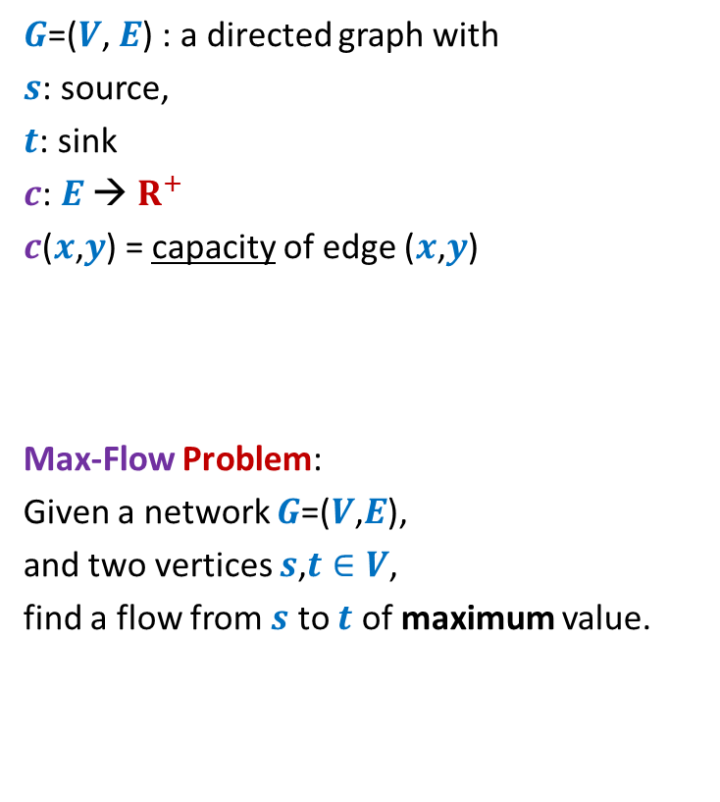
Formal Description of Flow
2
$\text{value}\text{(}f\text{)=}$ flow leaving $s$
$$=\sum_{\left(s,v\right) ∈ E}{f\text{(}u\text{,}v\text{)}}$$
$G$=($V$, $E$) : a directed graph with
$s$: source,
$t$: sink
$c$: $E$ → $R^{+}$
$c$($x$,$y$) = capacity of edge ($x$,$y$)
Max-Flow Problem:
Given a network $G$=($V$,$E$),
and two vertices $s$,$t∈V$,
find a flow from $s$ to $t$ of maximum value.
$$v$$
$$x$$
5
6
15
8
$$t$$
$$s$$
6
7
14
7
17
$$u$$
4
$$y$$

Slide 13

Towards designing max flow algorithm
2
Find some $s−t$ path,
Send flow along the path,
Update capacities,
Find some $s−t$ path,
…and so on ☺
$$v$$
$$x$$
5
6
5
5
+1
5
12
+7
6
15
What is the most natural approach to solve this problem ?
8
$$t$$
$$s$$
6
7
1
1
7
7
14
7
17
$$u$$
4
$$y$$

Slide 14
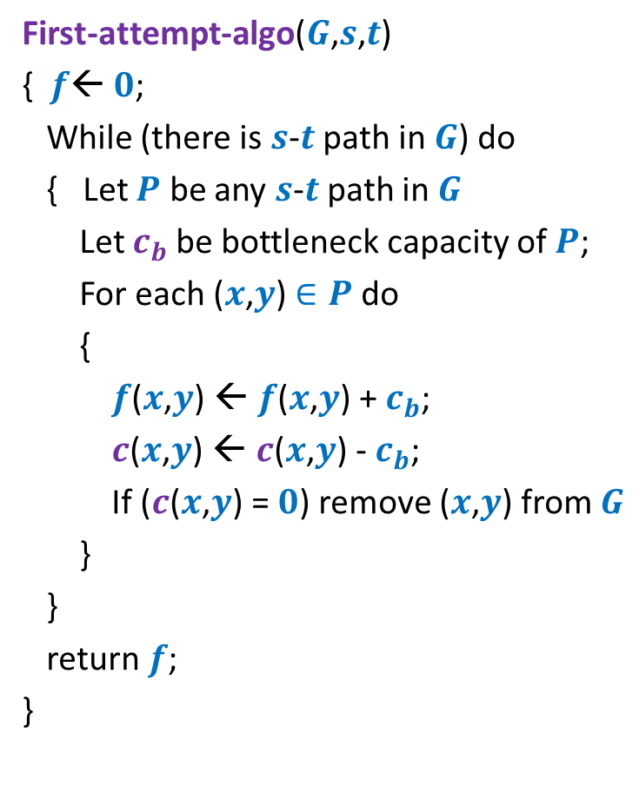
Towards designing max flow algorithm
First-attempt-algo($G$,$s$,$t$)
{ $f$← $0$;
While (there is $s$-$t$ path in $G$) do
{ Let $P$ be any $s$-$t$ path in $G$
Let $c_{b}$be bottleneck capacity of $P$;
For each ($x$,$y$) $∈P$ do
{
$f$($x$,$y$) ← $f$($x$,$y$) + $c_{b}$;
$c$($x$,$y$) ← $c$($x$,$y$) - $c_{b}$;
If ($c$($x$,$y$) = $0$) remove ($x$,$y$) from $G$
}
}
return $f$;
}
Is the algorithm correct ?

Slide 15
A counterexample for First-attempt-algo

Slide 16

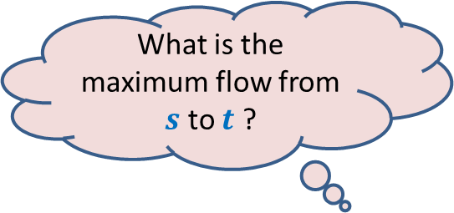



$$x$$
What is the maximum flow from $s$ to $t$ ?
20
10
$$s$$
50
$$t$$
30
10
20
$$y$$

Slide 17




Executing our first attempt algorithm
$$x$$
$$x$$
20
20
10
10
$$s$$
20
50
$$t$$
$$s$$
30
$$t$$
20
10
20
10
$$y$$
$$y$$
No $s−t$ path

Slide 18
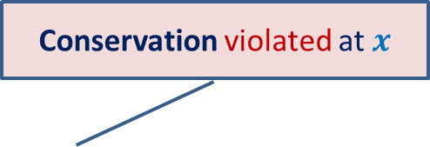
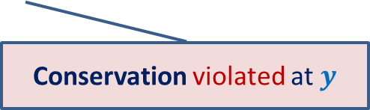

Finding a solution with scientific spirit
Conservation violated at $x$
Patience and perseverance paid ☺
$$x$$
20
10
20
10
How to send extra 10 units of flow from $s$to $t$ ?
$$s$$
20
$$t$$
10
50
10
20
10
20
$$y$$
Conservation violated at $y$

Slide 19
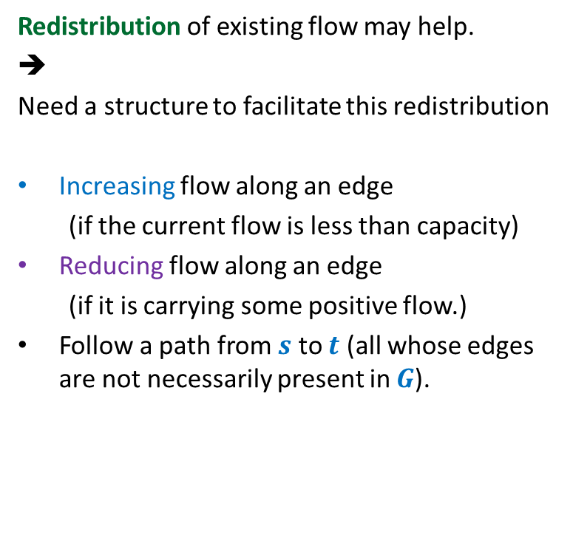
Insight gained from the example
Redistribution of existing flow may help.
➔
Need a structure to facilitate this redistribution
Increasing flow along an edge
(if the current flow is less than capacity)
Reducing flow along an edge
(if it is carrying some positive flow.)
Follow a path from $s$ to $t$ (all whose edges are not necessarily present in $G$).
$$x$$
20
10
20
10
$$s$$
10
50
$$t$$
10
20
10
20
Think for a while about the structure that will facilitate these operations.
$$y$$

Slide 20

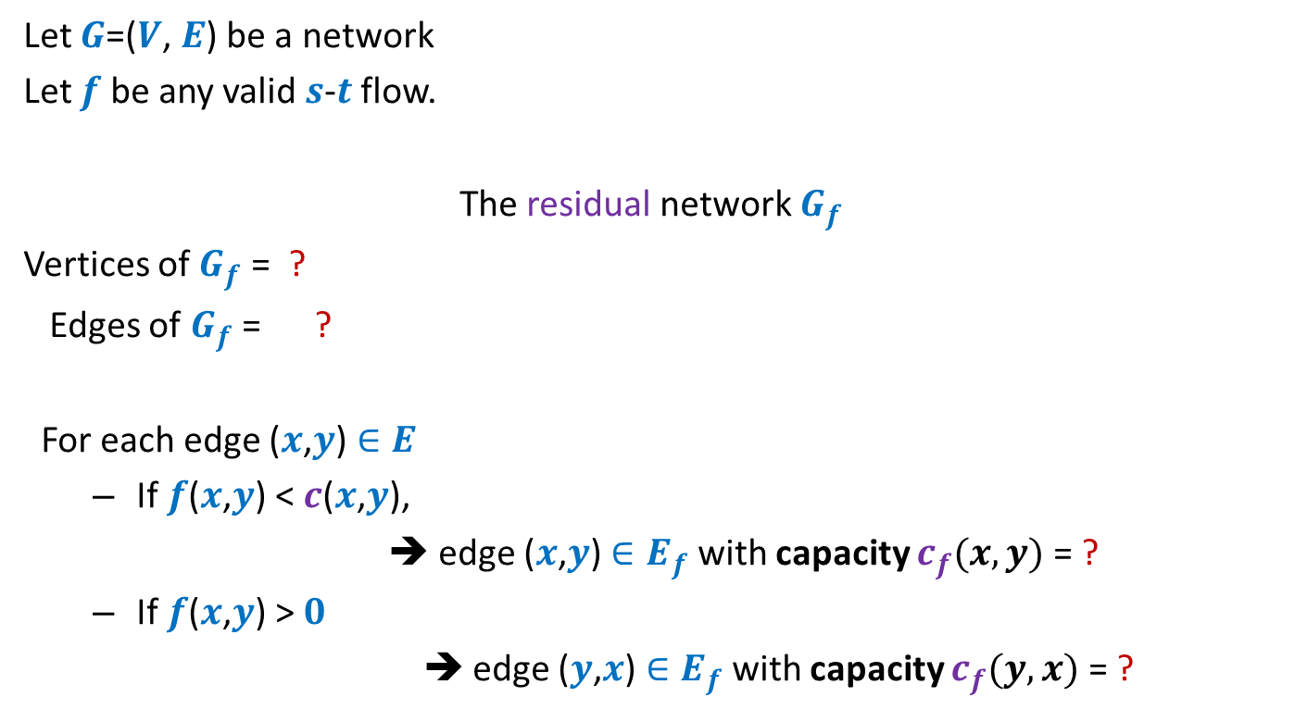



Residual network
Let $G$=($V$, $E$) be a network
Let $f$ be any valid $s$-$t$ flow.
The residual network $G_{f}$
Vertices of $G_{f}$ = ?
Edges of $G_{f}$ = ?
For each edge ($x$,$y$) $∈E$
If $f$($x$,$y$) < $c$($x$,$y$),
➔ edge ($x$,$y$) $∈E_{f}$ with capacity $c_{f}(x,y)$= ?
If $f$($x$,$y$) > $0$
➔ edge ($y$,$x$) $∈E_{f}$with capacity $c_{f}(y,x)$ = ?
$$V$$
$$E_{f}$$
Forward edge
$c$($x$,$y$) - $f$($x$,$y$)
Backward edge
$f$($x$,$y$)

Slide 21


Example of Residual Network
$$G$$
$$G_{f}$$
$$x$$
$$x$$
20
20
20
10
10
$$s$$
20
50
$$t$$
$$s$$
30
20
$$t$$
20
10
20
10
20
$$y$$
$$y$$

Slide 22
Example of Residual Network
$$G$$
$$G_{f}$$
$$x$$
$$x$$
20
20
10
20
10
10
$$s$$
20
50
$$t$$
$$s$$
30
20
$$t$$
10
10
20
10
20
10
20
$$y$$
$$y$$

Slide 23

Example of Residual Network
$$G$$
$$G_{f}$$
$$x$$
$$x$$
20
20
10
20
10
10
$$s$$
10
50
$$t$$
$$s$$
40
10
$$t$$
10
20
10
20
10
20
$$y$$
$$y$$
No $s−t$ path exists in $G_{f}$.

Slide 24












A generic step of increasing flow
Find a $s−t$ path $P$in $G_{f}$;
If edge ($x$, $y$) on the path is a forward edge
➔ Increase flow along ($x$, $y$) by $c′$ in $G$.
$$s$$
$$t$$
$$x$$
$$y$$
$$G$$
$$s$$
$$≥c′$$
$$≥c′$$
$$≥c′$$
$$t$$
$$x$$
$$y$$
$$P$$
$$G_{f}$$

Slide 25

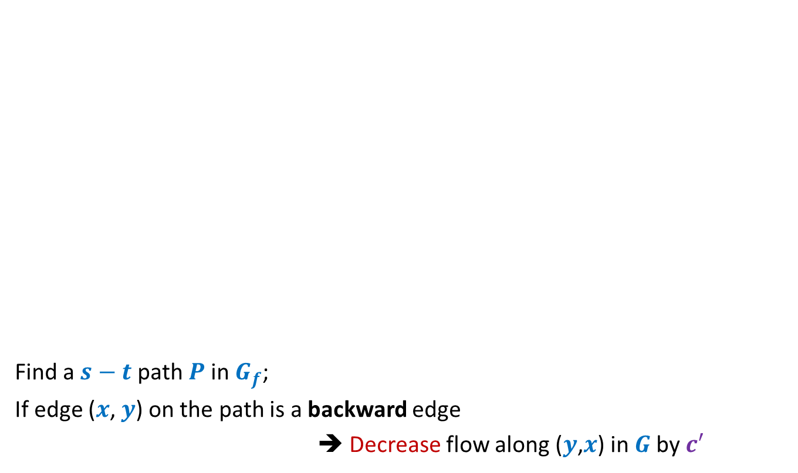
A generic step of increasing flow
Find a $s−t$ path $P$in $G_{f}$;
If edge ($x$, $y$) on the path is a backward edge
➔ Decrease flow along ($y$,$x$) in $G$by $c′$
$$s$$
$$t$$
$$x$$
$$y$$
$$G$$
This reduction of flow along ($y$,$x$) is a part of redistribution: we divert a part of $f$($y$,$x$) along some other outgoing edge of $y$, and increase flow along some edge entering $x$. Recall our example.
$$s$$
$$≥c′$$
$$≥c′$$
$$≥c′$$
$$t$$
$$x$$
$$y$$
$$P$$
$$G_{f}$$

Slide 26
Ford Fulkerson algorithm
A simple path based algorithm
+
Residual Network

Slide 27
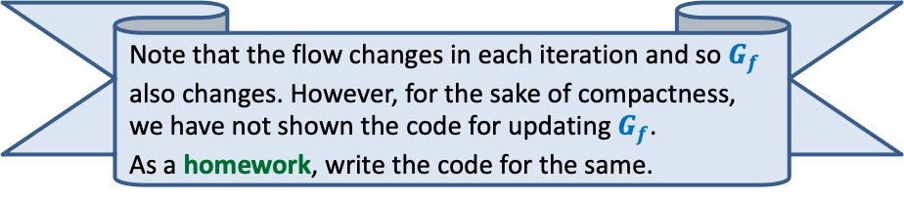
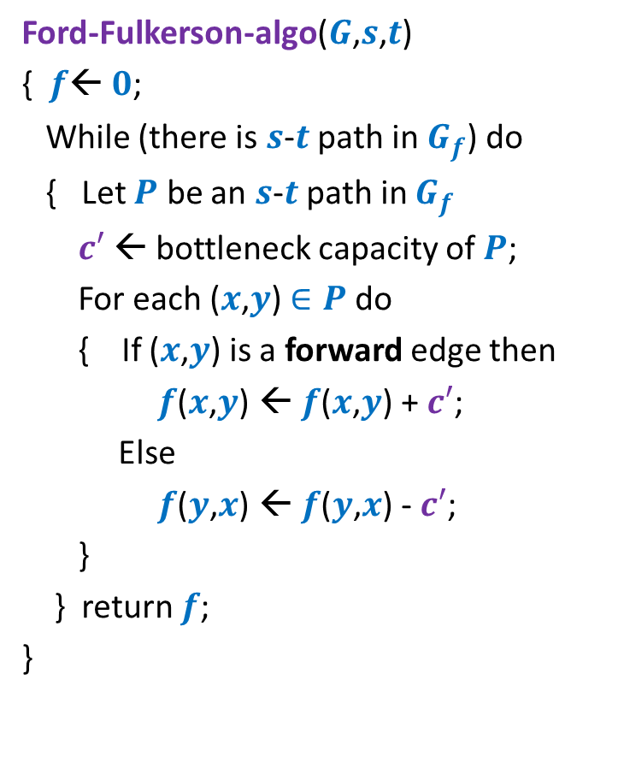
Ford Fulkerson algorithm
Ford-Fulkerson-algo($G$,$s$,$t$)
{ $f$← $0$;
While (there is $s$-$t$ path in $G_{f}$) do
{ Let $P$ be an $s$-$t$ path in $G_{f}$
$c′$ ← bottleneck capacity of $P$;
For each ($x$,$y$) $∈P$ do
{ If ($x$,$y$) is a forward edge then
$f$($x$,$y$) ← $f$($x$,$y$) + $c′$;
Else
$f$($y$,$x$) ← $f$($y$,$x$) - $c′$;
}
} return $f$;
}
Will this algorithm correctly compute the maximum flow?
How to prove it?
Note that the flow changes in each iteration and so $G_{f}$ also changes. However, for the sake of compactness, we have not shown the code for updating $G_{f}$.
As a homework, write the code for the same.

